Slide 1




An Approach Towards Brain Controlled System
Using EEG Headband and Eye Blink Pattern
Nilkanth K. Jadhav
Walchand College of
Engineering, Sangli
Bashirahamad F. Momin
Walchand College of
Engineering, Sangli

Slide 2
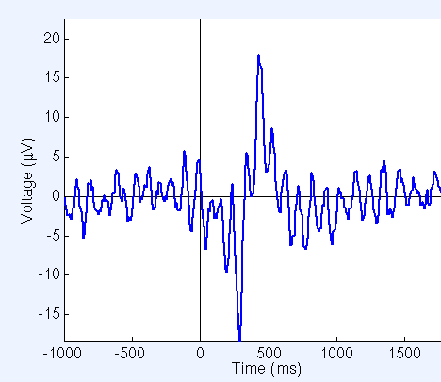
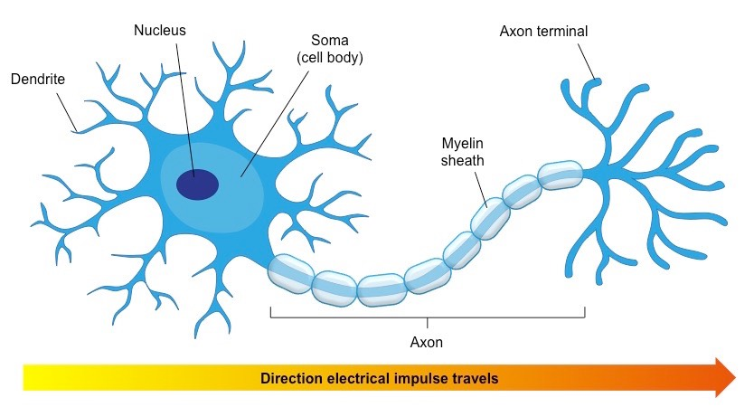
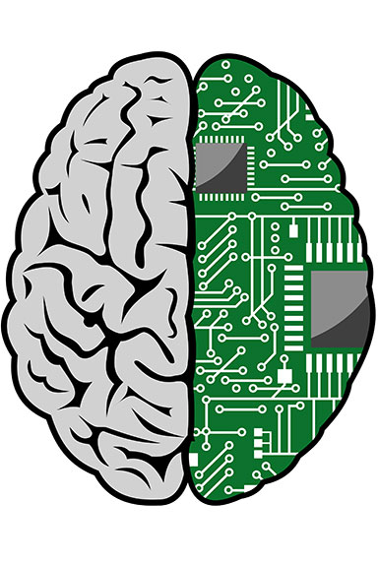
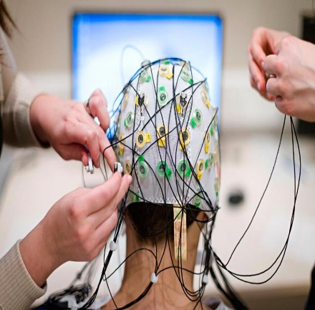
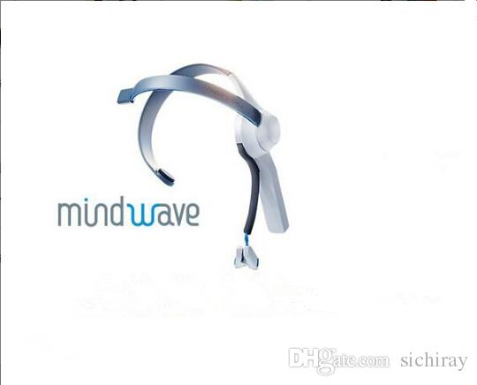
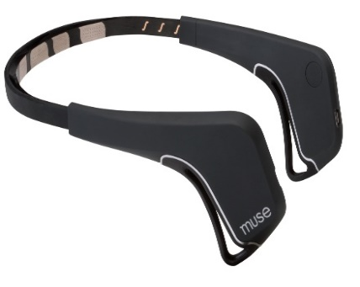
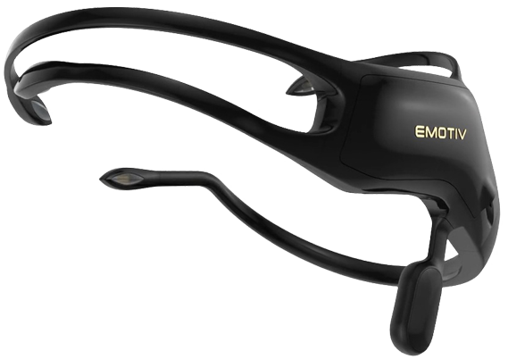
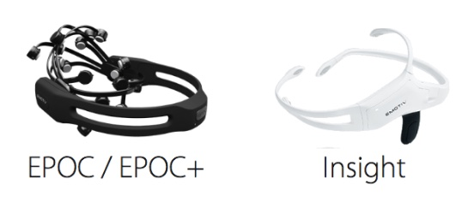
Introduction
Introduction
Neurons
Electroencephalography (EEG)
Wearable EEG Sensor
Brain–Computer Interfaces (BCI)
Brainwave Type | Frequency
Delta | < 4 Hz
Theta | 4 - 7 Hz
Alpha | 8 - 12 Hz
Beta | 12 - 36 Hz
Gamma | > 36Hz
Research Grade
EEG System

Slide 3
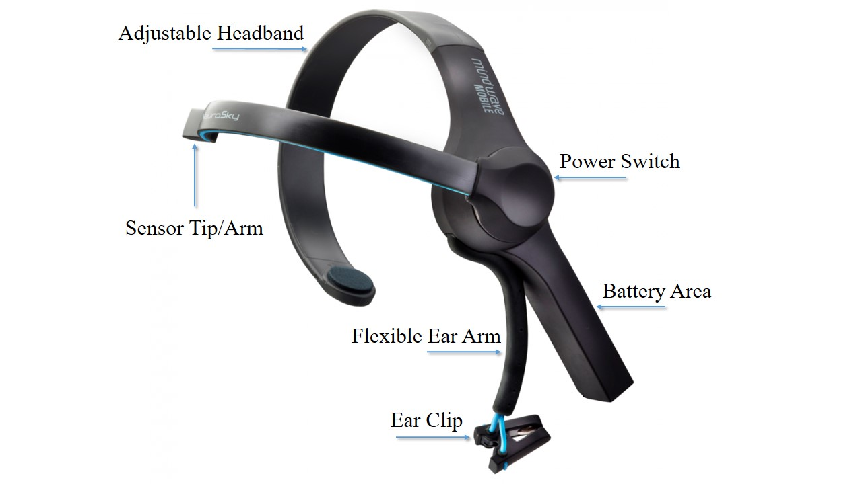
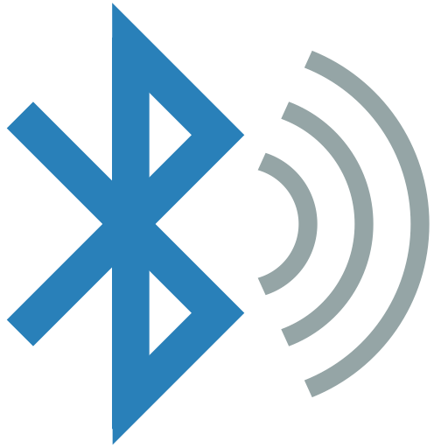
EEG Headband – Neurosky Mindwave
EEG Headband – Neurosky Mindwave

Slide 4
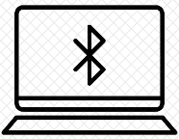
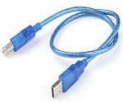

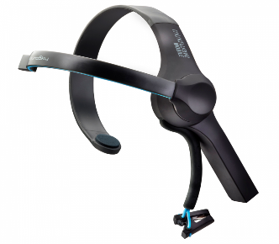
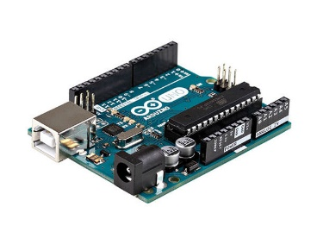
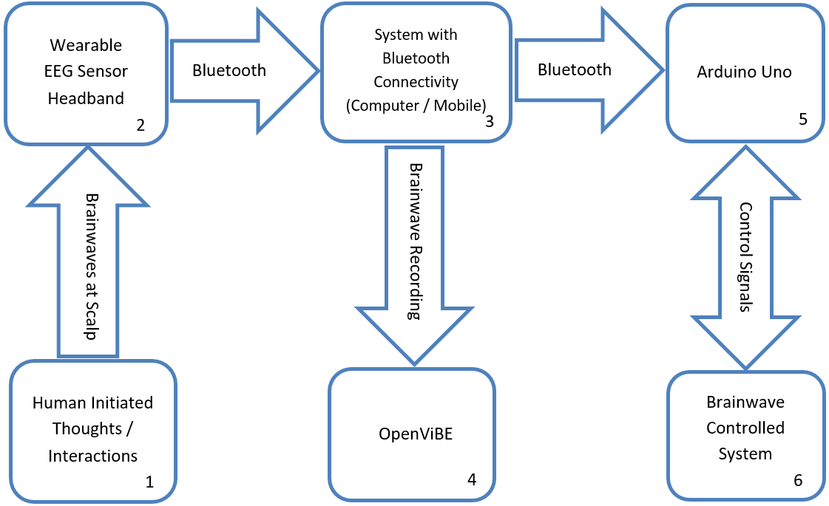
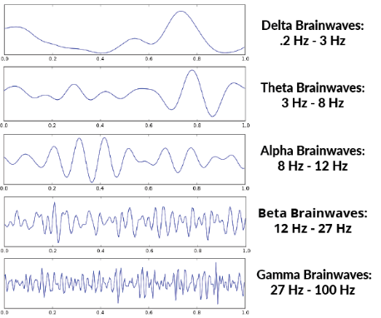

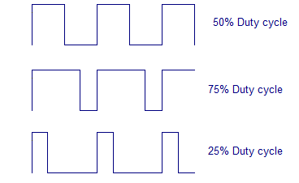
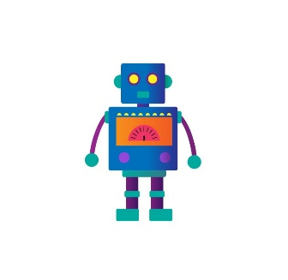


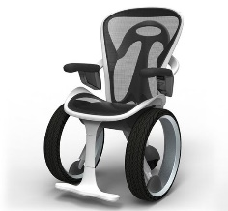
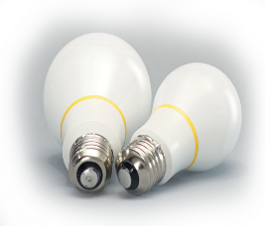
An approach Towards Brain Controlled System

Slide 5
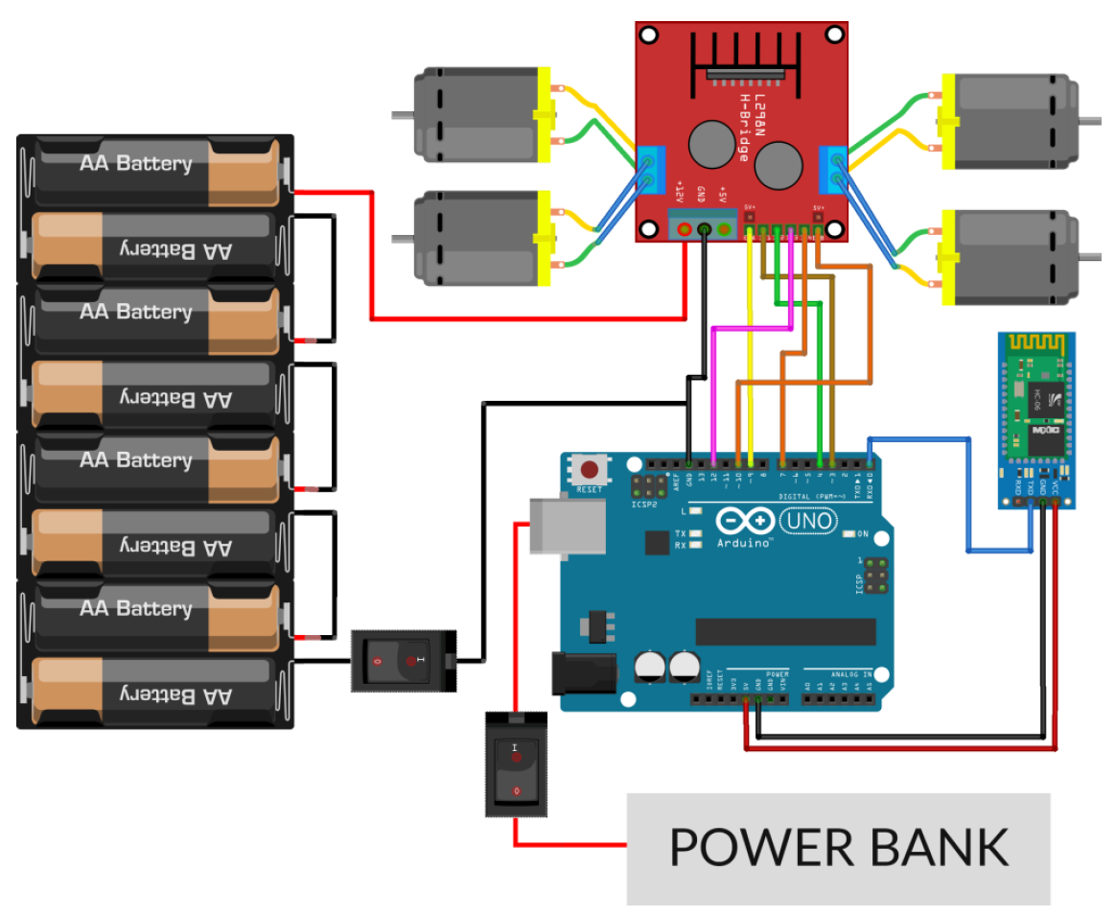
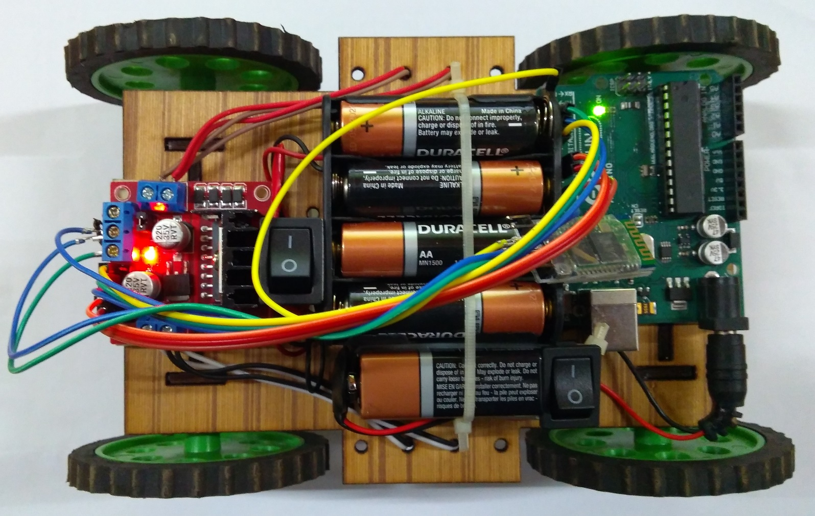
Software and Hardware Requirements
Software Requirements
Arduino IDE
Neurosky Mindwave EEG Headset Drivers
OpenViBE
Bluetooth Drivers
Android SDK
Hardware Requirements
Component | Count
Mindwave Mobile EEG Headband | 1
Arduino UNO | 1
Motor Driver L298N | 1
Bluetooth Module HC-05 | 1
DC Motors | 4
ON-OFF Buttons | 2
Toy Car Chassis | 1
1.5V AA Batteries | 8
9V Battery | 1
Jumper Wires | 30
Snap Connector for 9V battery | 1
8AA count Cell Socket | 1

Slide 6
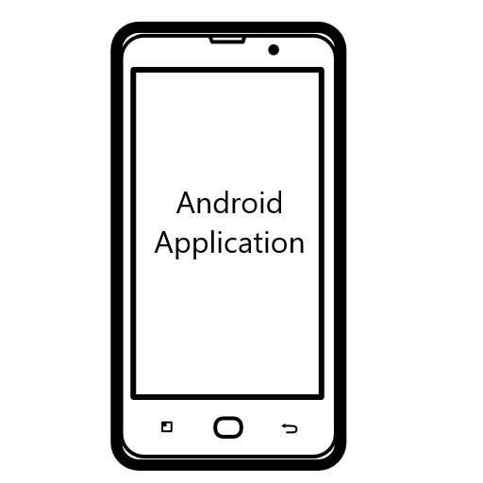

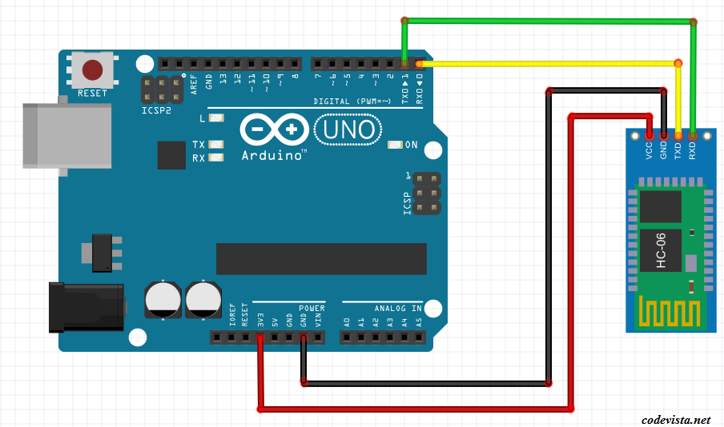


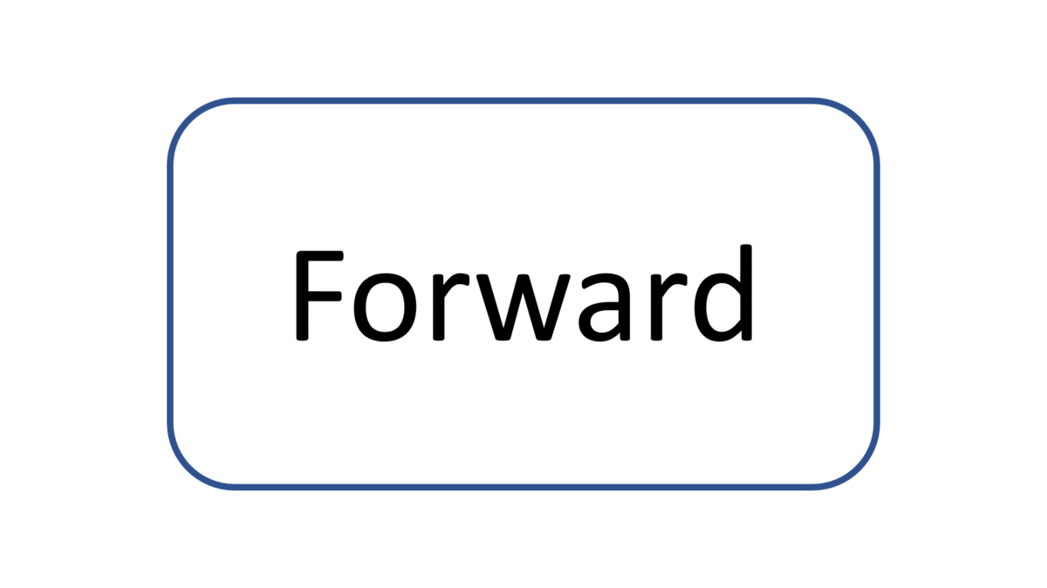
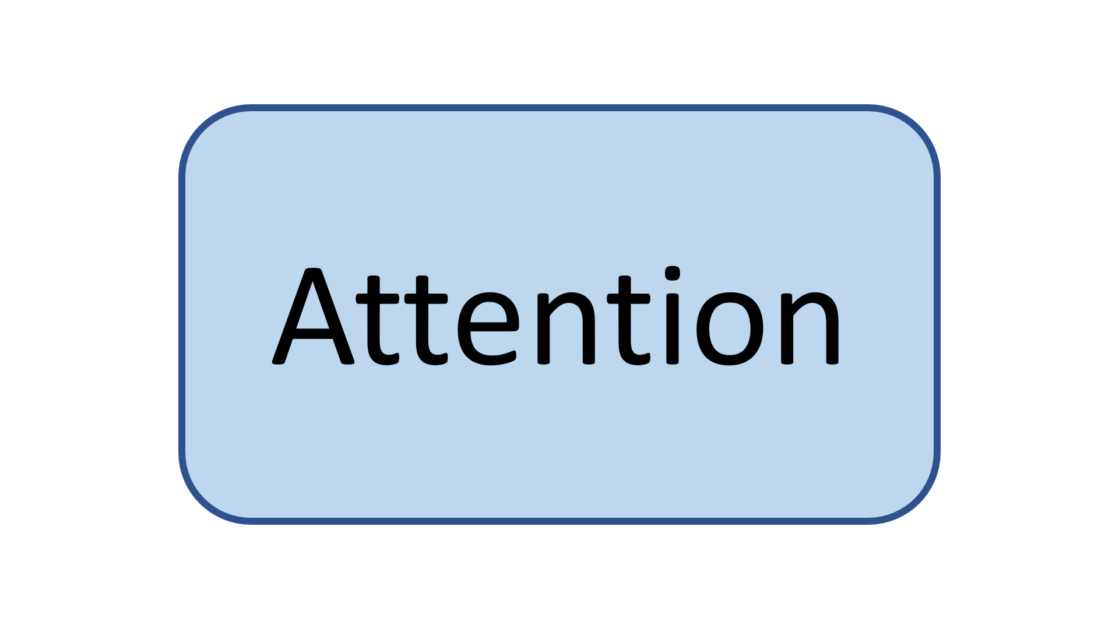
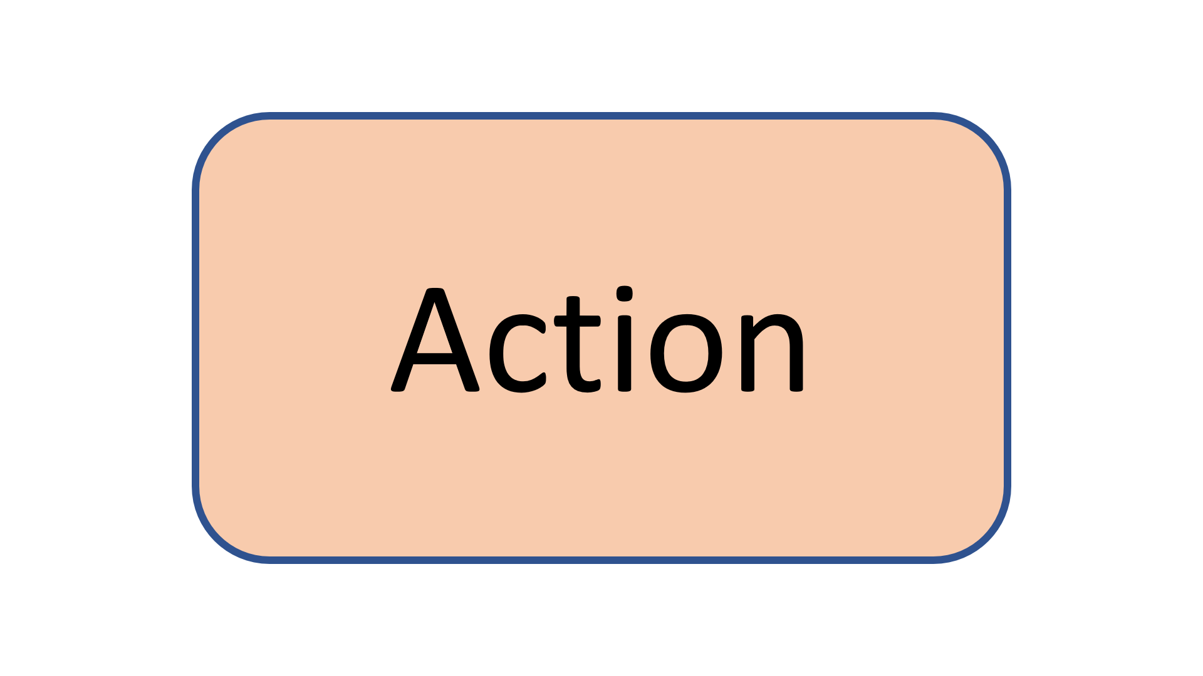
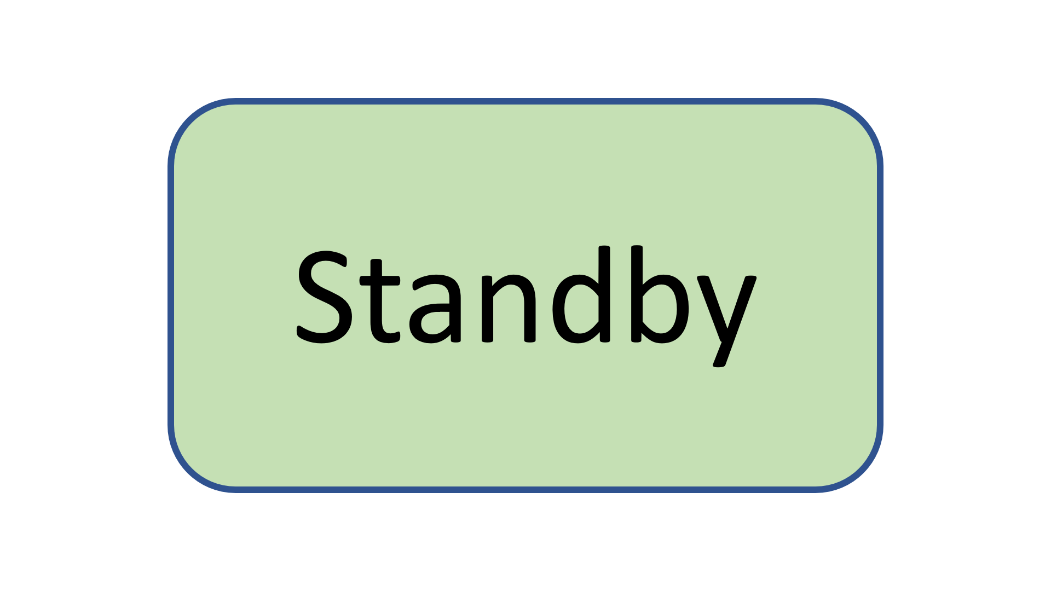
Eye Blink Pattern
and Attention Level
Command
(F,B,L,R)
Single
Blink
Double
Blink
Action Cycle
Focus Mode
Lock Action
Cycle Value
(Left)
Attention >
Threshold
Double
Blink
Blink Strength >
Threshold

Slide 7
Future Scope & Limitations
Opportunities
Virtual Reality
Prosthetic Organ Controls
Gaming with Mind Control (Attention - Meditation)
Systems for Physically Disabled or Paralyzed persons
Limitations
User needs to learn how to operate system at first
(same as first bicycle ride)
People with blink disorders will find it difficult
The consumer grade EEG sensor cannot identify a human being’s specific thoughts

Slide 8
Thank You.
Nilkanth K. Jadhav Email : mtech.nkjadhav@gmail.com +91 8087082261

